Slide 1
Things
The Internet of
Cars
Towards the future of the connected car
Jorgen Thelin
Notes:
We have all heard the phrase “Internet of Things” and the new buzzword “IoT” been used more and more these days, but what does that mean in practice?
Let’s look at some practical usage of IoT concepts and technology that is already being applied to modern automobiles.

Slide 2
Abstract
The Internet of Cars - Towards the Future of the Connected Car
No doubt you have heard the phrase “Internet of Things” and the new buzzword “IoT” been used more and more these days, but what does that mean in practice? The Tesla Model S is probably the most well-connected car on the planet at the moment, and in this presentation we will use that vehicle as a case study of some practical usage of IoT concepts and technology that is already being applied to modern automobiles. How far away are we from a future “Internet of Cars” and what will be the social and privacy impacts of more connected-car scenarios?

Slide 3
Definition: Internet of Things
“The Internet of Things is the network of physical objects that contain embedded technology to communicate and sense or interact with their internal states or the external environment.”
Source: Gartner IT Glossary http://www.gartner.com/it-glossary/internet-of-things/
Core requirements:
Physical
Identifiable
Connected
Telemetry
Control
Notes:
The “Internet of Things” concept has been attributed to Kevin Ashton in RFID Journal article in 1999.
"If we had computers that knew everything there was to know about things - using data they gathered without any help from us - we would be able to track and count everything, and greatly reduce waste, loss and cost. We would know when things needed replacing, repairing or recalling, and whether they were fresh or past their best".
http://www.techopedia.com/definition/28247/internet-of-things-iot
The Internet of Things (IoT) is a computing concept that describes a future where everyday physical objects will be connected to the Internet and be able to identify themselves to other devices.
The term is closely identified with RFID as the method of communication, although it also may include other sensor technologies, wireless technologies or QR codes.
The IoT is significant because an object that can represent itself digitally becomes something greater than the object by itself. No longer does the object relate just to you, but is now connected to surrounding objects and database data. When many objects act in unison, they are known as having "ambient intelligence.“

Slide 4
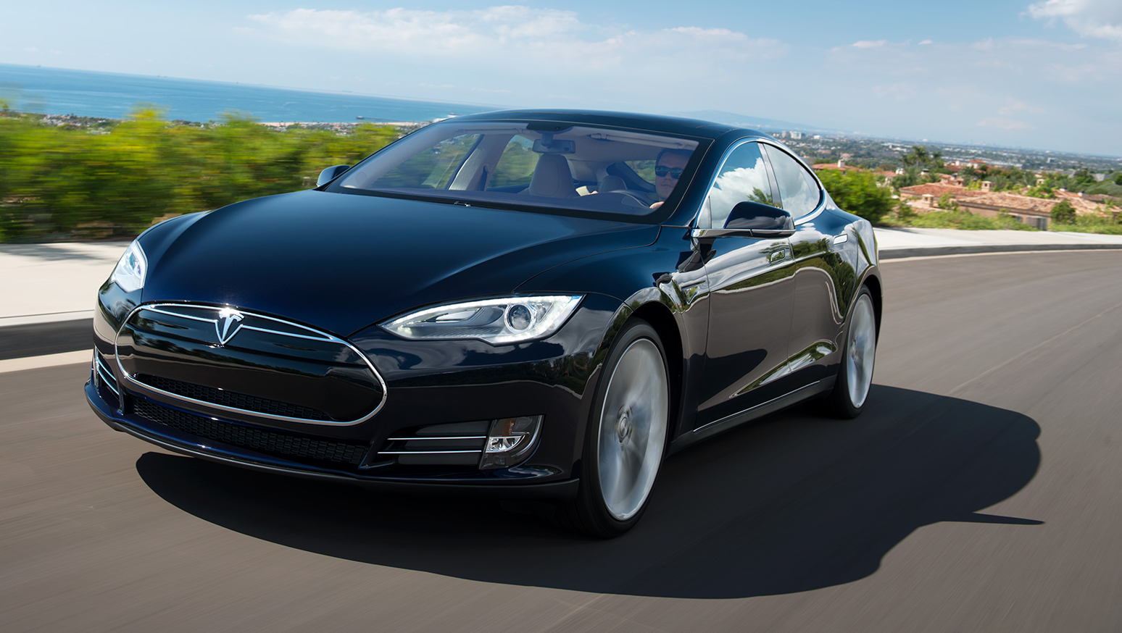
The Connected Car – Tesla Model S
Full Disclosure: I am proud owner of TSLA stock since 2010 IPO, and Tesla Model S since 2013.
IoT requirements:
Physical ☑
Identifiable ☑
Connected ☑
Telemetry ☑
Control ☑
Note: This is a technology case study, not a car advertisement!
Tesla Model S Source: Tesla Motors http://www.teslamotors.com/models/photo-gallery
Notes:
Tesla Model S is possibly the best car on the planet as a driver,
but it is also probably the most connected car on the planet too!
It fits all our definitions for Internet of Things core requirements.
It is a forerunner of connected car technology that we will see in other vehicles further down the road.
Tesla Model S Awards and Accolades:
2013 Motor Trends Car of the Year
Consumer Reports rating 99/100
Consumer Reports Top Picks 2014 - Best Overall

Slide 5
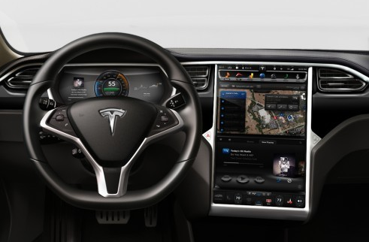
Tesla Model S – Networking & Connectivity
Connectivity
GSM 3G with HSPA+ using the AT&T’s network (and others) and using Sierra Wireless AR8550 (TMC Forum)
The Model-S hardware supports HSPA+, which AT&T considers 4G. A software update may be available in the 2014 time frame to add 4G support. The hardware does not support LTE.
Display – Instrument
12.3″ LCD, 1280 x 480 resolution
NVidia Tegra 2 dual core CPU (Mercury News, 15-May-2013)
Software – Linux, QT and custom Tesla code (PC Word interview)
Display – Primary
17″ LCD, 1080 x 1920 resolution
Nvidia’s Visual Computing Module VCM (Nvidia)
NVidia Tegra 3 quad-core +1 power-saving core (Nvidia blog)
Cypress MultiTouch controller (press release)
Software – Linux, QT and custom Tesla code (PC Word interview)
Source: Tesla Motors
Notes:
Tesla Model S is powered by some powerful computer technology that is more commonly seen in phones and tablets rather than cars.
Continuous 3G wireless network connection.
Infotainment services provided through 12.3” Instrument Panel & 17” Primary Panel – bigger than many laptops!
Display’s can safely be reset at any time, even while driving.
Instrument Panel - Reset by pressing top left and top right buttons at the same time on the steering wheel (safe to do anytime)
Primary Display Panel - Reset by pressing center left and center right scroll buttons at the same time on the steering wheel (safe to do anytime)

Slide 6
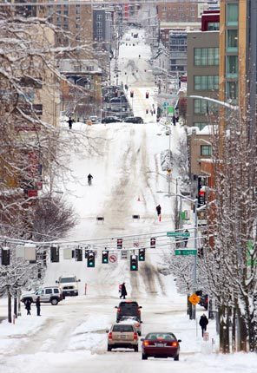
Networked Data Services – New Possibilities
Over-the-Air Software Updates & Patches
Add entirely new functionality to the car
For example: Hill Start Assist aka: Seattle has longer & steeper hills than Fremont, CA
Make feature updates
For example: improved cold weather range predictions
Fix any bugs in Car OS or Infotainment Apps
Data feed of near real-time traffic conditions
Source: Google Maps
Streaming Internet Radio
Slacker
TuneIn
Real-time GPS location
Transmit vehicle status telemetry
Source: Seattle Times
Notes:
Seattle has hills! Steep ones!
Telemetry data from cars showed drivers were having to press both Brake and Accelerator pedals together to do hill start after stop for traffic lights on steep incline. Car recorded alert condition, and was able to sent telemetry data feedback direct to Tesla for analysis.
So a new software update 5.9 added Hill Start Assist function in April 2014.
Hill Start Assist
“Hill Start Assist makes it easier to start driving on an incline. When Model S is on a hill, Hill Start Assist will automatically hold the car for one second when the brake pedal is released, preventing the car from rolling while the driver switches from the brake pedal to the accelerator. This function will engage when the car is in Drive and facing uphill, or in Reverse and facing downhill. “
Steepest Streets in Seattle:
http://www.seattle.gov/transportation/steepest.htm
Madison Street - 3rd Avenue to 4th Avenue = 19%
James Street - 4th Avenue to 5th Avenue = 18.3%
Cherry Street - 4th Avenue to 5th Avenue = 17.1%
Seneca Street - 3rd Avenue to 4th Avenue = 15.3%
University Street - 3rd Avenue to 4th Avenue = 10.2%
Spring Street - 4th Avenue to 5th Avenue = 10.0%
6th Avenue - University Street to Union Street = 8.0%
4th Avenue - James Street to Cherry Street = 4.7%
4th Avenue - Union Street to University Street = 3.9%
6th Avenue - Pike Street to Pine Street= 2.2%

Slide 7
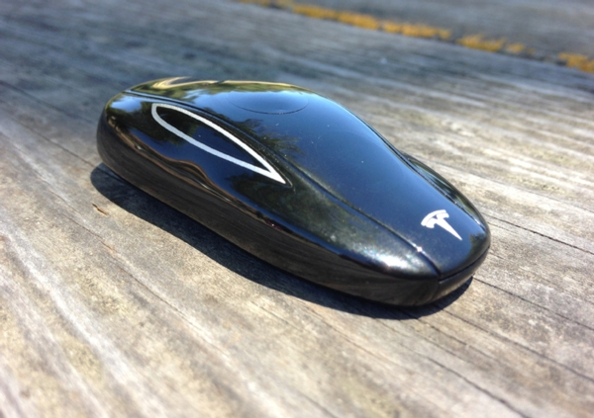
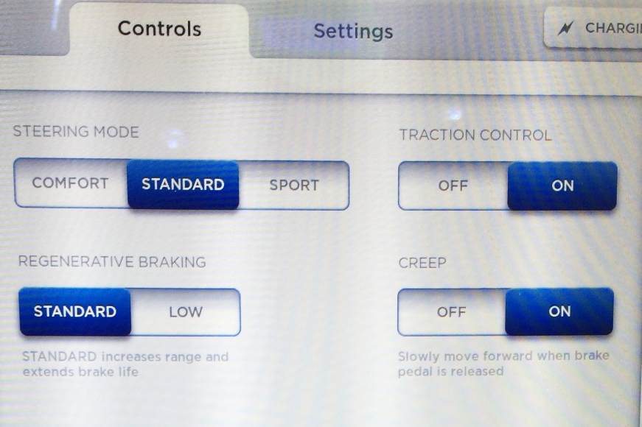
Sensors & Controls: Fly-By-Wire?
Software controlled switches handle all vehicle control functions
Car can detects proximity of key fob, else drive train disabled.
Remote door unlock and extend door handles, handles auto-present as driver approaches with key fob if Tech Package is installed. https://www.youtube.com/watch?v=ucwo9hnLiU8
Steering, including steering mode setting
Gear selection: P-N-R-D
Braking, including regen-braking
Driving lights & turn signals
HVAC
Door sensors / unlock [with manual override for emergency use]
Battery compartment temperature & air-flow
Vehicle ride-height at highway speed, if Air-Suspension options is fitted.
Source: Scientific American
Source: JThelin
Notes:
Not quite a flying car, but getting pretty close….
In Tesla Model S, everything is controlled by software.
Adjust the feel of the steering: Comfort, Standard of Sports mode.
Regenerative braking kicks in by variable amount when releasing the Accelerator pedal – don’t need to use brake pedal.
Door handles auto-extend functionality:
http://youtu.be/ucwo9hnLiU8
HVAC = heating, ventilation, and air conditioning.
And the key fob looks like the car! How cool is that?

Slide 8
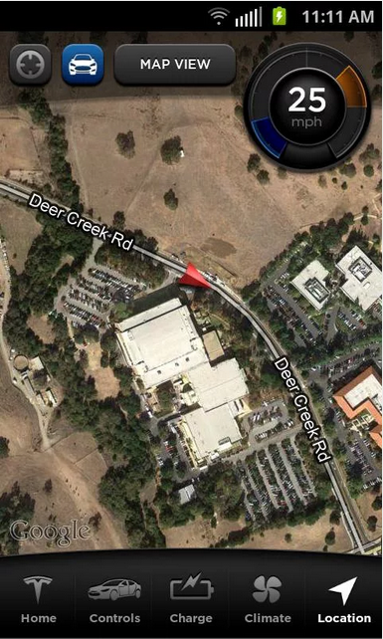
Telemetry – Many Different Uses
Vast amounts for real-time status data produced by each car – rich data mining opportunities.
Various Uses of the Data:
Complete fleet size and usage patterns data.
Analyze usage patterns for design of new features.
Example: Hill Start Assist functionality added in April 2014.
Safety monitoring
Examples: Any crashes detected, even if air-bags did not need deployment. http://www.gtspirit.com/2013/10/06/tesla-model-s-destroyed-in-the-usa/
Dude, Where’s My Car?
Source: Tesla Motors
Notes:
Tesla has access to complete fleet size and usage patterns data – not available to any other car manufacturer.
Safety
http://www.gtspirit.com/2013/10/06/tesla-model-s-destroyed-in-the-usa/ The driver of the vehicle that caused the major accident travelled away from the scene in an Ambulance and required hospital attention. The [Tesla driver] continued saying ‘Tesla called my home shortly afterwards saying that they received multiple alarms from the car and wanted to make sure I was ok. They picked up my car free of charge and transported it 50 miles to the nearest service center. They are also arranging a loaner Model S.’ It was also reported that no liquids seeped from the cars batteries.

Slide 9
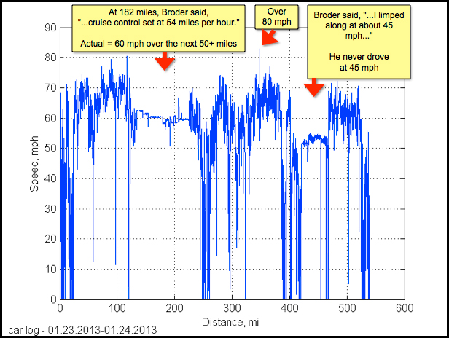
Telemetry – Fraud Detection
A Most Peculiar Test Drive
New York Times article by John Broder http://www.nytimes.com/2013/02/10/automobiles /stalled-on-the-ev-highway.html
Public rebuttal of NYTimes article with full telemetry data analysis by Tesla Motors http://www.teslamotors.com/blog/most-peculiar-test-drive http://www.teslamotors.com/blog/most-peculiar-test-drive-follow
When Life Gives You Lemons
Milwaukee attorney Vince Megna filed “Lemon Law” case against Tesla Motors claiming defective vehicle.
Tesla released public statement detailing all the remedial steps they had attempted on that vehicle. http://www.teslamotors.com/blog/when-life-gives-you-lemons
The key to the rebuttal came from telemetry data:
Another issue was that the car's fuse blew on numerous occasions. Each time, our engineers explored all possible explanations and were never able to find anything wrong with the car. Still, just to be sure, we replaced several parts that could have been related to the alleged problem – all at no expense to the customer. When the fuse kept blowing despite the new parts, and faced with no diagnosis showing anything wrong with the car, the engineers were moved to consider the possibility that the fuse had been tampered with. After investigating, they determined that the car's front trunk had been opened immediately before the fuse failure on each of these occasions. (The fuse is accessed through the front trunk.) Ultimately, Tesla service applied non-tamper tape to the fuse switch. From that point on, the fuse performed flawlessly!
Source: Tesla Motors
Notes:
Milwaukee attorney Vince Megna describes himself as the “Lemon Law King” of Wisconsin. He was representing physician Robert Montgomery in a claim that Mr. Montgomery’s Tesla Model S was defective.
It's also of interest to note that this particular lawyer filed a lemon law suit against Volvo in February 2013 – on behalf of the very same client.
Moral of the story: Don’t try to commit fraud against a car which has full telemetry data collection!

Slide 10
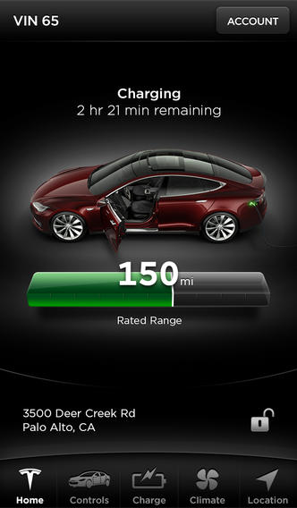
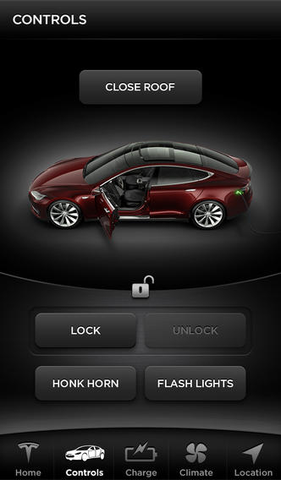
A Remote Control Car?
Tesla Model S -- REST API
Vehicle Status
Is mobile access enabled
Charge state
Climate controls state
Driving state and location
GUI settings (preferences)
Vehicle state [Doors open
Vehicle Control Commands
Open charge port door
Set charge mode to standard
Set charge mode to max-range
Set charge limit to X %
Start charge
Stop charge
Flash lights
Honk horn
Lock doors
Unlock doors
Sun roof control [open / close / vent]
Set AC target temperature
Start AC
Stop AC
Unofficial docs: http://docs.timdorr.apiary.io/
Internet connectivity enables remote monitoring and limited control of the vehicle.
Safety interlocks disable remote control fucntions while car is in motion.
But no RC driving!
Well, at least not yet ... ! http://www.technovelgy.com/ct/Science-Fiction-News.asp?NewsNum=2627
Source: Tesla Motors
Notes:
We saw James Bond driving car remotely in 1997 movie Tomorrow Never Dies.
Compare with prototype iDriver app demonstrated by Artificial Intelligence Group at Freie Universität in Berlin.
http://www.technovelgy.com/ct/Science-Fiction-News.asp?NewsNum=2627
Various remote status monitoring and control functions available through Tesla Model S REST API.
Unofficial documentation of the Tesla Model S REST API is available here: http://docs.timdorr.apiary.io/
In many ways, these remote control apps provide a case study in the exploration of what types of remote-control functions are useful in a connected car.
Some cars already have Automated Self-Park functions, which in some ways is functionally similar to RC driving!

Slide 11
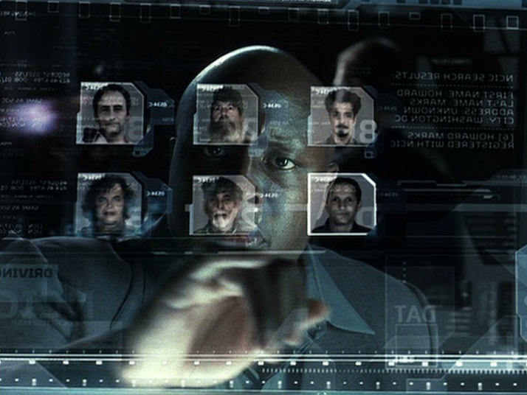
Connected Privacy?
Should we be worried about the type and amount of telemetry data our cars will soon start to reveal about details of our lives?
Rhetorical question: Is this any different than the data emitted by your cellphone & other mobile apps?
Even if your car does not tell anyone where it is, your cellphone probably already does through various location-based services.
iBeacon, Bing / Google Maps, Yelp, Facebook, etc
According to Jeff Jonas (IBM Fellow & Chief Scientist for Entity Analytics)
Space-Time Box data from cellphones and other portable gadgets can already be used to fairly accurately identify individual “habitrail” signals. http://jeffjonas.typepad.com/jeff_jonas/2009/08/your-movements-speak-for-themselves-spacetime-travel-data-is-analytic-superfood.html
Will the benefits of a connected car out-weigh any privacy concerns?
Only you can decide!
Notes:
Jeff Jonas has been called the “Wizard of Big Data”
http://jeffjonas.typepad.com/about.html
http://news.nationalgeographic.com/news/innovators/2014/05/140505-jeff-jonas-big-data-gambling-computers-technology-ibm/
Space-time travel data (also known as “Space Time Box” data) includes:
Where you travel from and to
What time you travel
How many stops you make
What speed you drive
From this data, a “habitrail” can fairly easily be derived that gives the moving habits of a person.
http://jeffjonas.typepad.com/jeff_jonas/2009/08/your-movements-speak-for-themselves-spacetime-travel-data-is-analytic-superfood.html
“Your space-time-travel data makes where you live and where you work self-evident, and it reveals your most frequent, periodic, infrequent and rare destinations.
The data reveals the number of co-workers that join you Thursdays after work for a beer, and roughly where you all go. It knows where these same co-workers call home, and just exactly what kind of neighborhood they come from (e.g., average income, average home price) … information certainly useful to attentive direct marketing folks.”
Harvard Business Review has said that Data Scientist if “the sexiest job of the 21st Century”
http://hbr.org/2012/10/data-scientist-the-sexiest-job-of-the-21st-century/ar/1

Slide 12
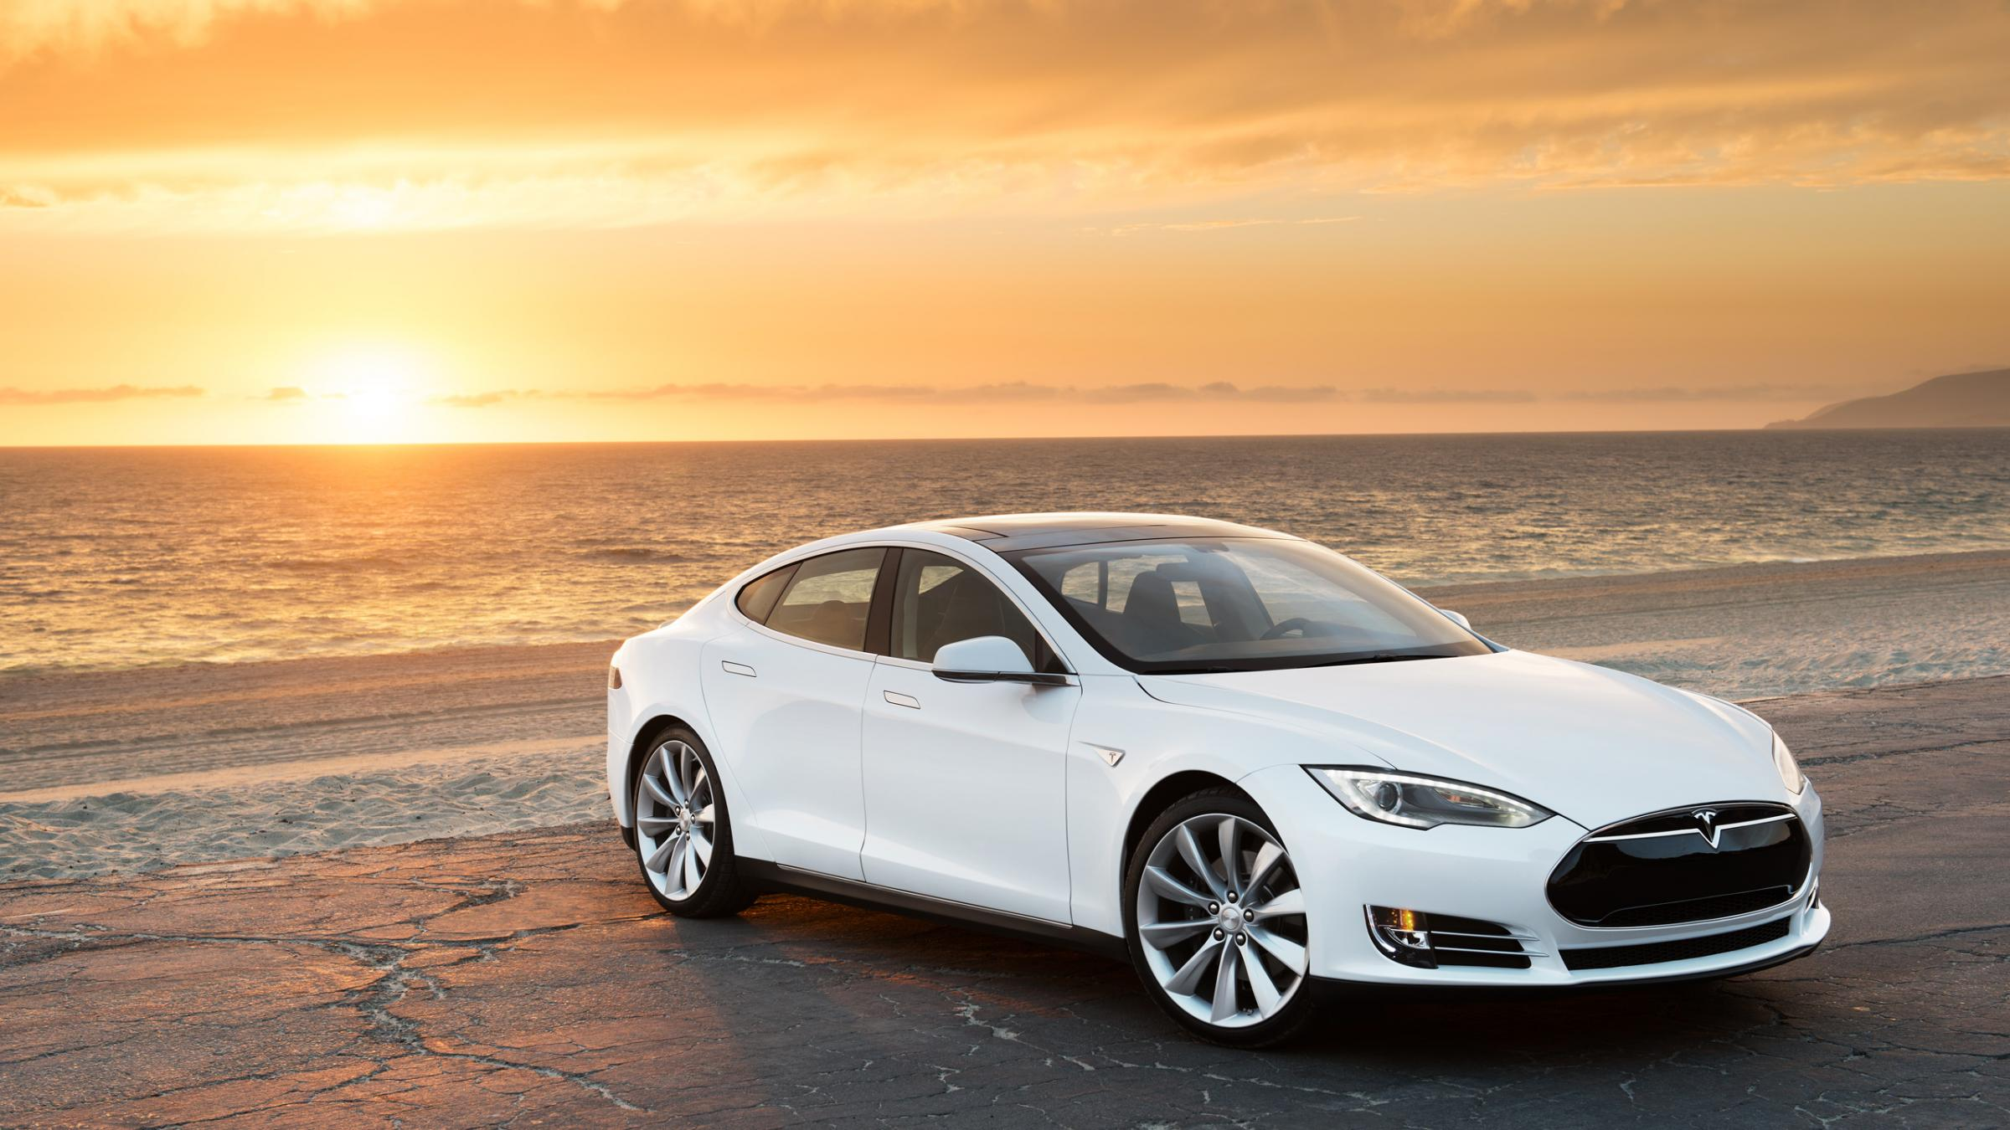
The future of the connected car is only just beginning…..
Source: Tesla Motors

